Slide 1
IAATO.ORG
BECOMING AN
ANTARCTIC
AMBASSADOR
A ‘how to’ presentation to support your ambassadorship journey

Slide 2
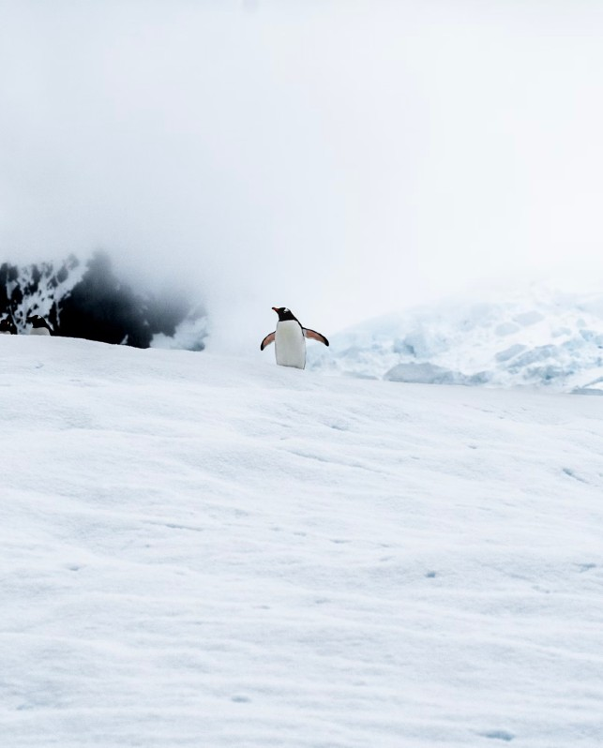
WHAT WE’LL COVER
IAATO definition of an Antarctic Ambassador
How to continue your journey
Antarctic Ambassadorship Day
Ambassadorship resources
Now let’s dive in!

Slide 3
AN ANTARTIC
AMBASSADOR LEAPS!

Slide 4
Loves and respects the region.

Slide 5
Loves and respects the region.
Educates others by sharing their experiences.

Slide 6
Loves and respects the region.
Educates others by sharing their experiences.
Advocates for Antarctica when opportunities arise.

Slide 7
Loves and respects the region.
Educates others by sharing their experiences.
Advocates for Antarctica when opportunities arise.
Protects Antarctica by making positive changes at home.

Slide 8
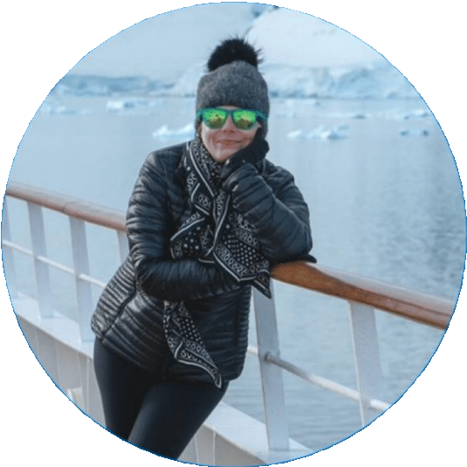
MEET YOUR PEERS
Mandy Speers Volpe, Designer & Photographer, NYC
When Mandy and husband Noel arrived home after a “life- changing” Antarctic expedition 2018, they began transitioning to plastic-free living; from ditching the single use water bottles at the gym to saying no to plastic in everyday life.
Mandy has also shared her experience with “more people than I can count” explaining the network of organisations that support the protection of Antarctica and the measures visitors must follow when travelling there.
MANDY SPEERS VOLPE

Slide 9
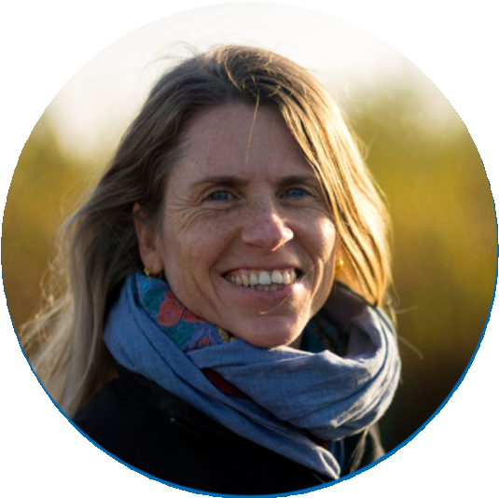
MEET YOUR PEERS
Ethel Borggreven - Ploum, Occ. Therapist, Netherlands
Ethel was so inspired by her expedition in 2016, she wanted to share it with others. She created a presentation using her photographs and anecdotes, as well as tips on how to protect Antarctica with environmentally responsible practices at home.
Her first lecture, at a local outdoor shop, was a great success with 76 people in attendance, buzzing with enthusiasm for t he white continent and onward stewardship. She’s since gone on to book two more, and is looking to expand her lecture circuit.
ETHEL BORGGREVEN - PLOUM
ETHEL BORGGREVEN - PLOUM

Slide 10
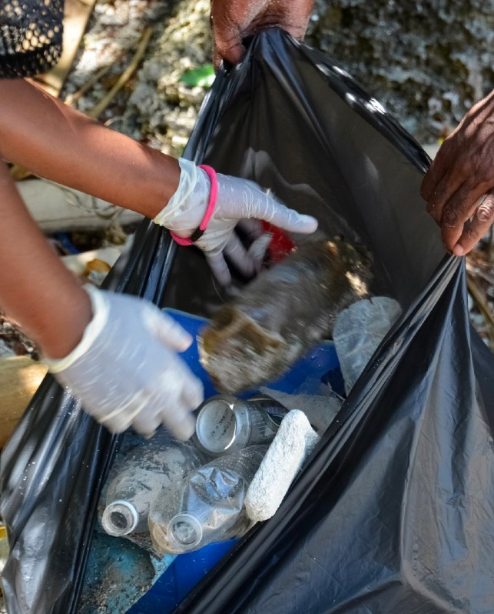
AMBASSADORSHIP
AT HOME
There are plenty of things you can do at home in the name of Antarctic Ambassadorship.
REDUCE
SHARE
PICK-UP
Encourage friends and family to stop or reduce their household single- use plastic waste.
Give a polar presentation for your local school or community group.
Organise a trash pick at a nearby beauty spot or community space.

Slide 11
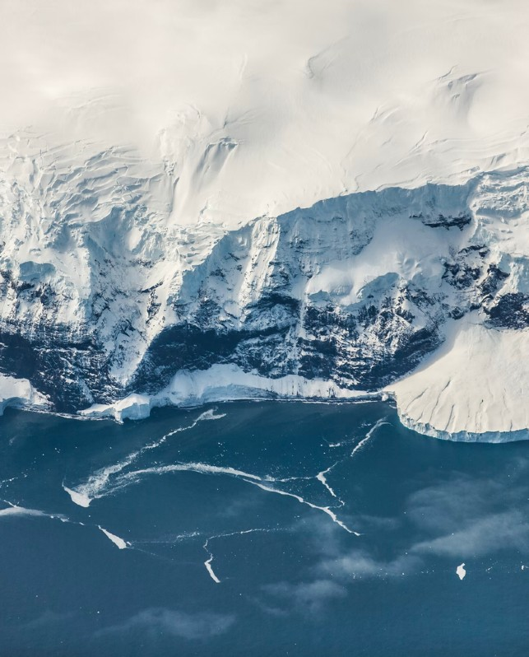
ANTARCTIC
AMBASSADORSHIP
DAY
As part of IAATO’s 30th anniversary celebrations in 2021, the association announced the launch of Antarctic Ambassadorship Day!
CELEBRATE
HONOUR
INSPIRE
A celebration of Antarctic Ambassadors, IAATO’s mission, achievements and aspirations
Sharing stories from our Ambassadors and acknowledging the actions they’ve taken in the name of ambassadorship
Releasing resources to support others in starting their ambassadorship journey or taking it to the next level.

Slide 12
FIND MATERIALS ON
OUR WEBSITE
IAATO.ORG
Find all Antarctic Ambassador materials as they become available at iaato.org
1
2
You’ll find Antarctic Ambassadors resources on the Antarctic Ambassadors pages via the Main Menu.
Over the course of the year you’ll find webinars, downloadable resources, content ideas and key messages here.

Slide 13
JOIN THE
IAATO.ORG
#Antarctic
Ambassadors
CONVERSATION
@antarctic_ambassadors
@AntarcticAmbassadors
Follow us and share your ambassadorship journey on social using #antarcticambassadors

