Slide 1
BECOMING AN ANTARCTIC AMBASSADOR
How to join our global community and act for Antarctica
Notes:
As a member of the International Association of Antarctica Tour Operators (IAATO) we share the belief that Antarctic expeditions with responsible and robust environmental practices at their core create among visitors a greater understanding of the environment, Antarctica’s value to global science and how changes to the region can impact us all. These individuals return home as Antarctic Ambassadors – and I’m going tell you how you can earn that prestigious title during your expedition with us.
[TIP: Personalise this presentation by adding your company logo next to the Antarctic Ambassadors badge]

Slide 2
WHAT WE’LL COVER
What is an Antarctic Ambassador?
Acts of Ambassadorship
Become an Antarctic Ambassador during your visit
Ambassadorship at home
Notes:
During this short presentation we’ll be covering the definition of an Antarctic Ambassador, what Antarctic Ambassadors do, how you can become one during your own Antarctic experience with us and how you can continue that Ambassadorship journey at home.
[TIP: Tell your guests what you do as an Antarctic Ambassador and why it’s important to you].

Slide 3
AN ANTARCTIC AMBASSADOR LEAPS!
Notes:
An Antarctic Ambassador LEAPS! Which means an Antarctic Ambassador…

Slide 4
Loves and respects the region.
Notes:
Loves and respects the region…

Slide 5
Loves and respects the region.
Educates others by sharing their Antarctic experiences.
Notes:
Educates others by sharing their Antarctic experiences…

Slide 6
Loves and respects the region.
Educates others by sharing their Antarctic experiences.
Advocates for Antarctica when opportunities arise.
Notes:
Advocates for Antarctica when opportunities arise, and…

Slide 7
Loves and respects the region.
Educates others by sharing their Antarctic experiences.
Advocates for Antarctica when opportunities arise.
Protects Antarctica by making positive changes at home.
Notes:
Protects Antarctica by making positive changes at home.
But what does this mean in real terms? Here are some examples from former Antarctic expeditioners like yourselves…

Slide 8
Ethel Borggreven – Ploum, Occ. Therapist, Netherlands
Ethel was so inspired by her expedition in 2016, she wanted to share it with others. She created a presentation using her photographs and anecdotes, as well as tips on how to protect Antarctica with environmentally responsible practices at home.
Her first lecture, at a local outdoor shop, was a great success with 76 people in attendance, buzzing with enthusiasm for the White Continent and onward stewardship. She’s since gone on to book two more, and is looking to expand her lecture circuit.
ETHEL BORGGREVEN – PLOUM
Notes:
Ethel was so inspired by her expedition in 2016, she wanted to share it with others. She created a presentation using her photographs and anecdotes, as well as tips on how to protect Antarctica with environmentally responsible practices at home.
Her first lecture, at a local outdoor shop, was a great success with 76 people in attendance, buzzing with enthusiasm for the White Continent and onward stewardship. She’s since gone on to book two more, and is looking to expand her lecture circuit.
But standing up in front of an audience isn’t for everyone, so what else can Antarctic Ambassadors do?
[TIP: Replace this example with your own from past guests].

Slide 9
Mandy Speers Volpe, Designer & Photographer, NYC
When Mandy and husband Noel arrived home after a “life-changing” Antarctic expedition 2018, they began
transitioning to plastic-free living; from ditching the single use water bottles at the gym to saying no to plastic in everyday life.
Mandy has also shared her experience with “more people than I can count” explaining the network of organisations that support the protection of Antarctica and the measures visitors must follow when travelling there.
MANDY SPEERS VOLPE
Notes:
When Mandy and husband Noel arrived home after a “life-changing” Antarctic expedition 2018, they began transitioning to plastic-free living; from avoiding single use water bottles at the gym to saying no to plastic in everyday life.
Mandy has also shared her experience with “more people than I can count” through conversation, explaining the network of organisations that support the protection of Antarctica and the measures visitors must follow when travelling there.
[TIP: Replace this example with your own from past guests].
If you’re the kind of person who wants to make a positive impact at home for the good of Antarctica, you can start right here with us!

Slide 10
WHILE YOU❜RE WITH US
Why not take the Antarctic Ambassador Expedition
Challenge!
SIX small acts of Ambassadorship while you’re with us
THREE to complete at home
Notes:
We have a specially designed Expedition Challenge just for you. All you have to do is six small acts of Ambassadorship during your time with us to receive your Certificate of Ambassadorship and become an official Antarctic Ambassador. These acts include attending lectures, making mindful menu choices to avoid food waste and turning off the lights in your [cabin/accommodation] when not in use.
There are even three tasks to complete at home to help make your Antarctic experience last that little bit longer and continue your Ambassadorship journey. You can join the Ambassadorship World Map and have your acts of Ambassadorship featured to inspire others, join the conversation by following the Antarctic Ambassadors community on social media and start a conversation by posting a comment.

Slide 11
ONWARD AMBASSADORSHIP
There are plenty of things you can do at home in the name of Antarctic Ambassadorship.
REDUCE
SHARE
PICK-UP
Reduce emissions by walking or cycling instead of driving short distances.
Give a polar presentation for your local school or community group.
Organise a trash pick at a nearby nature spot or community space.
Notes:
If you enjoy the expedition and at home challenge - and your shiny new title - you can take your Antarctic Ambassador status to the next level from home. This could be:
Saying no to single use plastic,
educating Antarctic enthusiasts in your local community by sharing your own experiences,
organising a trash pick at the beach or nature spot… or
choosing to leave the car at home for shorter journeys and enjoy a walk instead.
There’s also an international day to celebrate your contributions…!

Slide 12
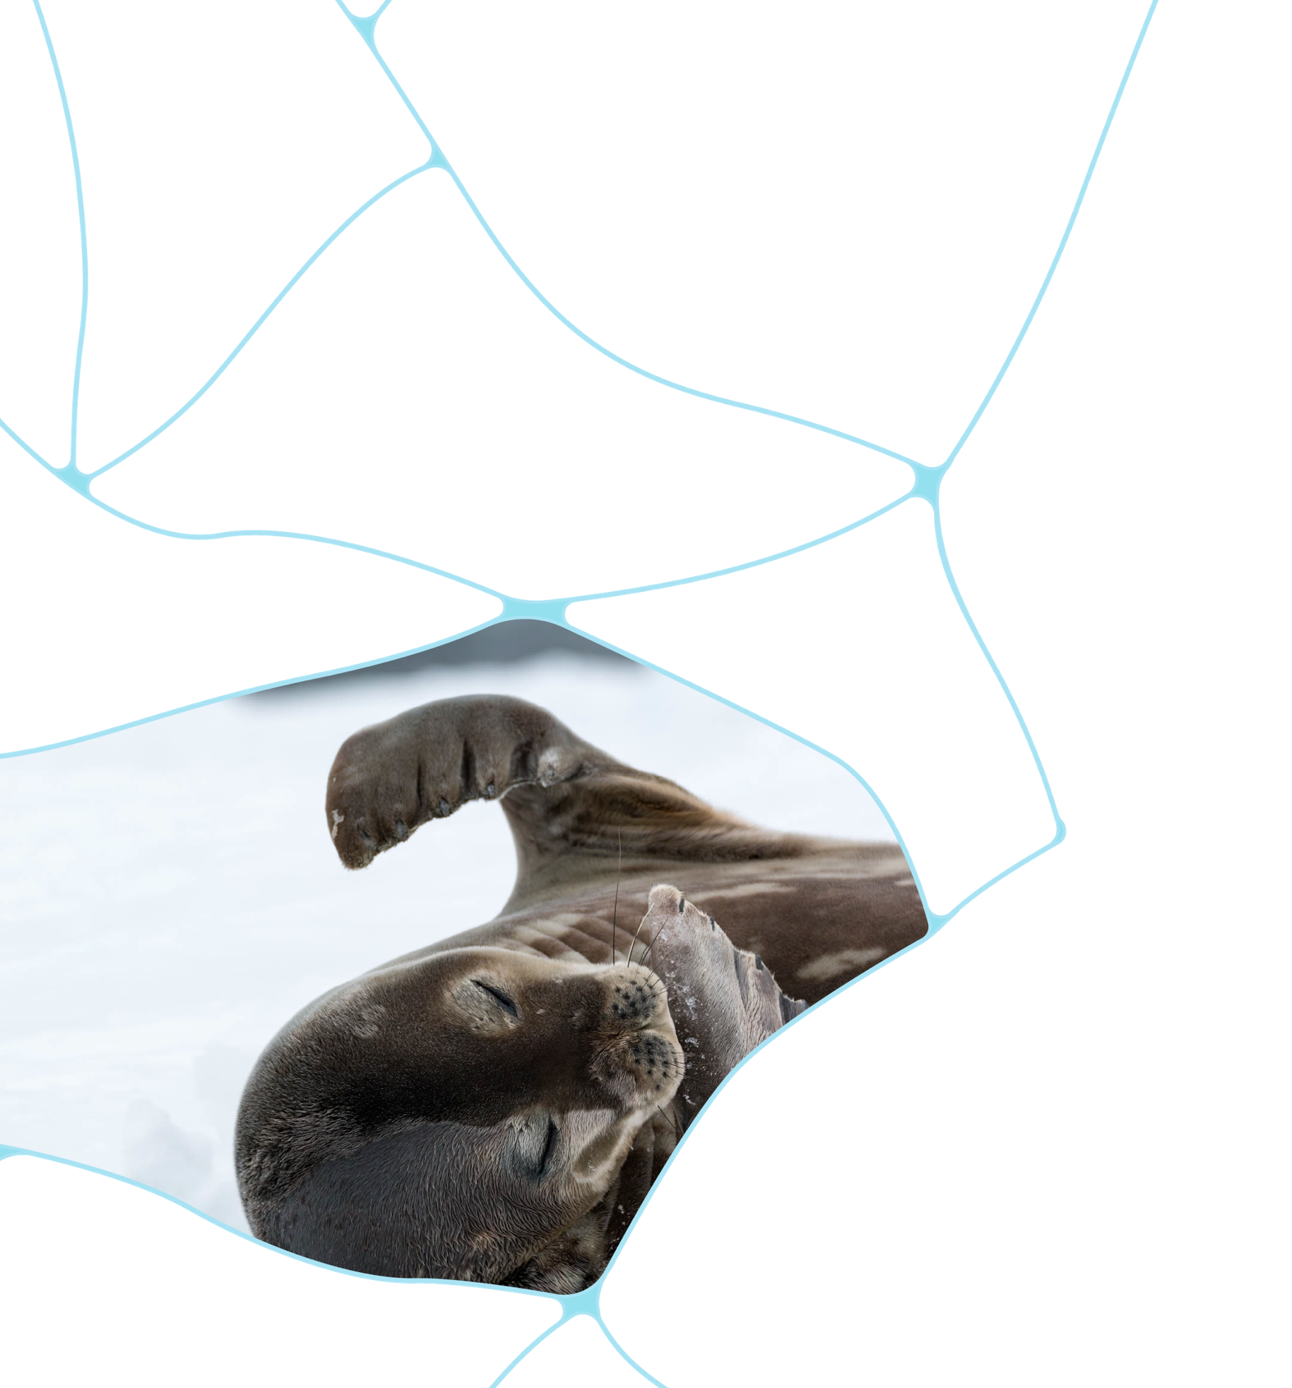
ANTARCTIC AMBASSADORSHIP DAY
APRIL 24
CELEBRATE
HONOUR
INSPIRE
A celebration of Antarctic Ambassadors, IAATO’s mission, achievements and aspirations.
Sharing stories from our Ambassadors and acknowledging the actions they’ve taken for Antarctica.
Releasing new resources to support your ambassadorship journey.
Notes:
Antarctic Ambassadorship Day was launched in 2021 on IAATO’s 30th anniversary and is held on April 24th.
The global event celebrates Antarctic Ambassadors, IAATO’s mission of advocating and promoting the practice of safe and environmentally responsible Antarctic tourism as well as our achievements as a community.
It’s also an opportunity to share stories from Antarctic Ambassadors and acknowledge the actions they have taken for Antarctica.
Finally, it’s designed to inspire! By releasing new resources, online events, challenges and more, the hope is that not only will you be inspired to continue your Ambassadorship journey, but others will join and the global community will continue to grow.

Slide 13
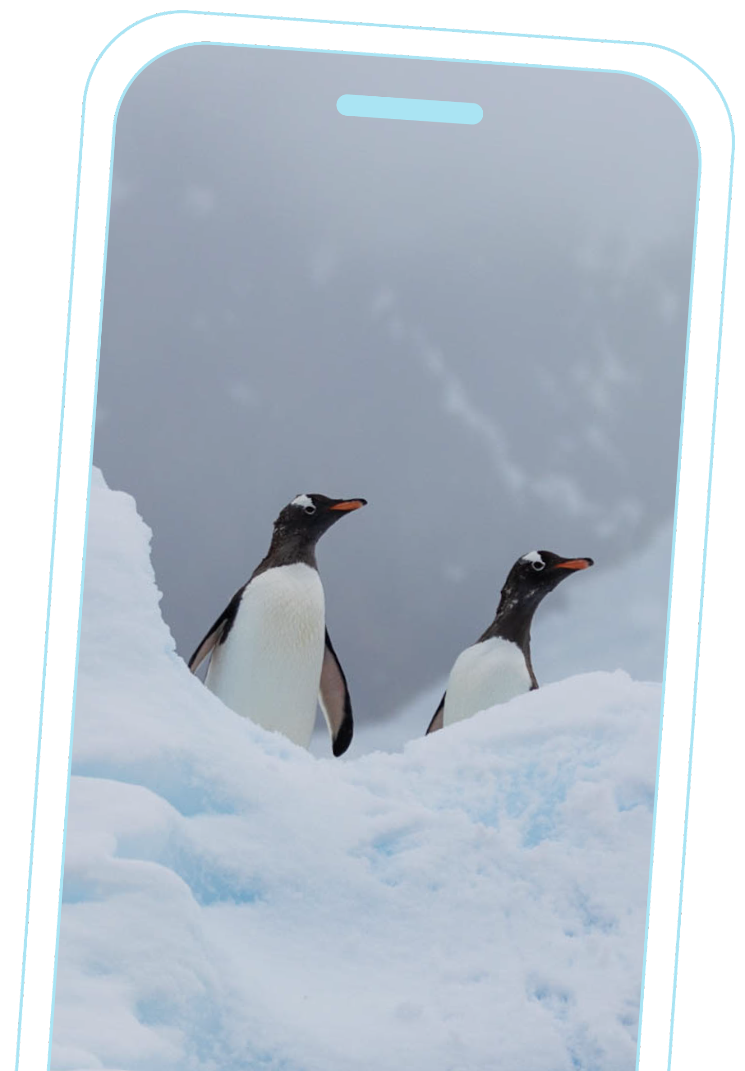
FIND MORE RESOURCES ONLINE
Find all Antarctic Ambassador materials as they become available at iaato.org
1
You’ll find Antarctic Ambassadors resources on the Antarctic Ambassadors pages via the Main Menu.
2
Over the course of the year you’ll find downloadable resources, tutorials, events and activities here.
iaato.org/antarctic-ambassadors
Notes:
Find everything you need to get involved on IAATO’s website – just look for the Antarctic Ambassador pages or we have the web address here for anyone that would like to take a note or a quick photo.
On these pages and the Antarctic Ambassador social media accounts, IAATO hosts events, releases resources, shares recommended reading lists and posts blogs and tutorials.

Slide 14
JOIN THE CONVERSATION
#Antarctic
Ambassadors
@antarctic_ambassadors
@AntarcticAmbassadors
Follow us and share your ambassadorship journey on social using #AntarcticAmbassadors
Notes:
If you want to get a head-start on your Ambassador journey, you can follow Antarctic Ambassadors on Facebook and Instagram (you can also tag them in your Antarctic photos to have them showcased on their page).
[Conclude the presentation by telling guests who to speak to about taking part in the Expedition Challenge and asking for questions].

